Slide 1

Chapter 2
Fundamentals of the Analysis of Algorithm Efficiency
Copyright © 2007 Pearson Addison-Wesley. All rights reserved.

Slide 2
The Analysis Framework
Analysis of algorithms
Efficiency
Time efficiency
Space efficiency
Time efficiency is more important than Space efficiency
Notes:
Analysis of algorithms means an investigation of an algorithm’s efficiency with respect to two resources: running time and memory space
There are two kinds of efficiency: time efficiency and space efficiency. Time efficiency, also called time complexity, indicates how fast an algorithm in question runs. Space efficiency, also called space complexity, refers to the amount of memory units required by the algorithm in addition to the space needed for its input and output.
Now the amount of extra space required by an algorithm is typically not of as much concern as before. In addition, the research experience has shown that for most problems, we can achieve much more spectacular progress in speed than in space. Therefore, we primarily concentrate on time efficiency, but the analytical framework introduced here is applicable to analyzing space efficiency as well.

Slide 3
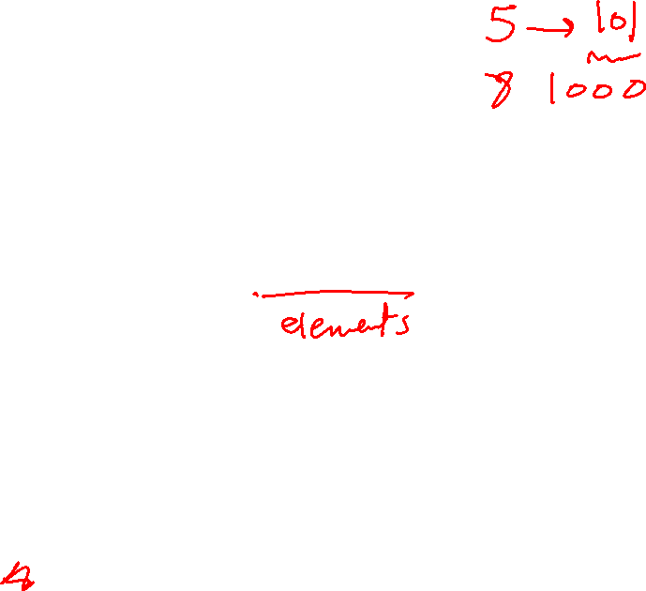
Measuring an Input’s Size
In most cases, it is straightforward (List size for sorting, searching, finding smallest element problems).
There are situations, where there are two natural measures of size (computing the product of two n × n matrices).
Or N as a sum of sizes of two matricies.
The choice of an appropriate size metric can be influenced by operations of the algorithm in question (a spell-checking algorithm.
Number of characters or number of words.
In some problems, the number’s magnitude determines the input size (checking primality of a positive integer n).
b= : 𝑏=⌊〖𝑙𝑜𝑔〗_2 𝑛⌋+1 (number of bits of n)
Notes:
Let’s start with the obvious observation that almost all algorithms run longer on larger inputs. For example, it takes longer to sort larger arrays, multiply larger matrices, and so on. Therefore, it is logical to investigate an algorithm’s efficiency as a function of some parameter n indicating the algorithm’s input size.
In most cases, selecting such a parameter is quite straightforward. For example, it will be the size of the list for problems of sorting, searching, finding the list’s smallest element.
There are situations, like computing the product of two n × n matrices, where there are two natural measures of size for this problem. The first is the matrix order n. But the other natural contender is the total number of elements N in the matrices being multiplied. (The latter is also more general since it is applicable to matrices that are not necessarily square).
The choice of an appropriate size metric can be influenced by operations of the algorithm in question. For example, how should we measure an input’s size for a spell-checking algorithm? If the algorithm examines individual characters of its input, we should measure the size by the number of characters; if it works by processing words, we should count their number in the input.
In some problems such as checking primality of a positive integer n, the input is just one number, and the number’s magnitude determines the input size. In such situations, it is preferable to measure size by the number b of bits in the n’s binary representation: 𝑏=⌊〖𝑙𝑜𝑔〗_2 𝑛⌋+1.

Slide 4
Units for Measuring Running Time
Standard units of time measurement (a second, or millisecond) cannot be used to measure the algorithm efficiency.
The possible approach is to compute the number of times the basic operation is executed.
We should emphasize on the count’s order of growth for large input sizes.
Notes:
Standard units of time measurement (a second, or millisecond) cannot be used to measure the algorithm efficiency, because the running time of a program implementing the algorithm depends on the speed of a particular computer, the quality of a program implementing the algorithm and the compiler used in generating the machine code. Therefore, for algorithm’s efficiency, we would like to have a metric that does not depend on these extraneous factors.
The possible approach is to count the number of times of executing the most important operation of the algorithm, called the basic operation, the operation contributing the most to the total running time.
The basic operation of an algorithm is usually the most time-consuming operation in the algorithm’s innermost loop. For example, comparing elements (keys) in sorting algorithms and arithmetical operations: addition, subtraction, multiplication, and division. Of the four, the most time-consuming operation is division, followed by multiplication and then addition and subtraction, with the last two usually considered together.
We should emphasize on the count’s order of growth for large input sizes, why? A difference in running times on small inputs is not what really distinguishes efficient algorithms from inefficient ones. When we have to compute, for example, the greatest common divisor of two small numbers, it is not immediately clear how much more efficient Euclid’s algorithm is compared to the other two algorithms discussed in chapter 1. It is only when we have to find the greatest common divisor of two large numbers that the difference in algorithm efficiencies becomes both clear and important.

Slide 5
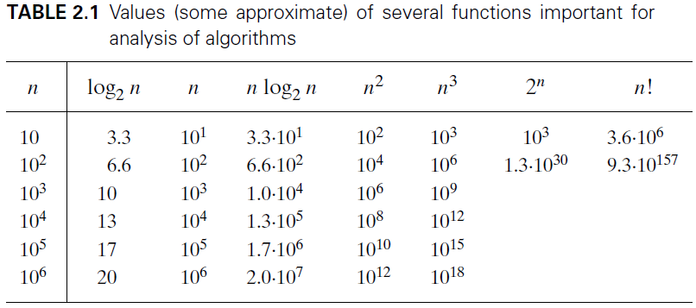

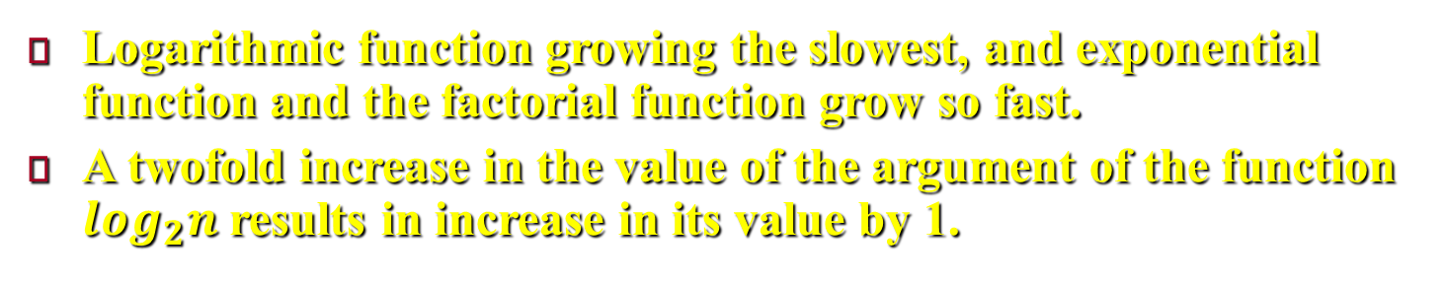
Orders of Growth
Logarithmic function growing the slowest, and exponential function and the factorial function grow so fast.
A twofold increase in the value of the argument of the function $\log_{2}n$ results in increase in its value by 1.
Notes:
For large values of n, it is the function’s order of growth that counts: just look at Table 2.1, which contains values of a few functions particularly important for analysis of algorithms.
The function growing the slowest among these is the logarithmic function. It grows so slowly, in fact, that we should expect a program. We omit a logarithm’s base and write simply log n in situations where we are interested just in a function’s order of growth.
On the other end of the spectrum are the exponential function 2^𝑛 and the factorial function n! Both these functions grow so fast.
Another way to appreciate the qualitative difference among the orders of growth of the functions in Table 2.1 is to consider how they react to, say, a twofold increase in the value of their argument n. The function log_2 𝑛 increases in value by just 1 (because log_2 𝑛 = log_2 2 + log_2 𝑛 = 1+ log_2 𝑛); the linear function increases twofold, the linearithmic function 〖𝑛log〗_2 𝑛 increases slightly more than twofold; the quadratic function 𝑛^2 and cubic function 𝑛^3 increase fourfold and eightfold, respectively (because 〖"(2n)" 〗^2 = 4𝑛^2 and 〖(2𝑛)〗^3 = 8𝑛^3); the value of 𝑛^2 gets squared (because 𝑛^2𝑛 = 〖"(" 2^𝑛 ")" 〗^2); and n! increases much more than that (yes, even mathematics refuses to cooperate to give a neat answer for n!).

Slide 6
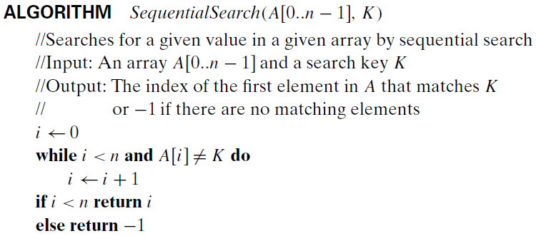
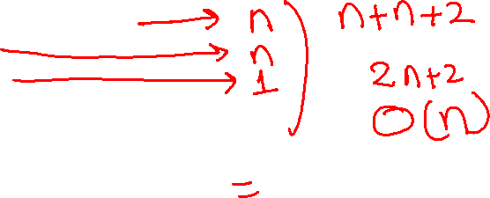

Worst-Case, Best-Case, and Average-Case Efficiencies
Many algorithms depends also on the specifics of a particular input.
Notes:
There are many algorithms for which running time depends not only on an input size but also on the specifics of a particular input. Consider, as an example, sequential search.

Slide 7
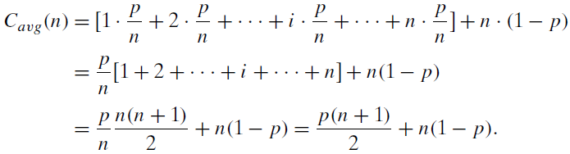
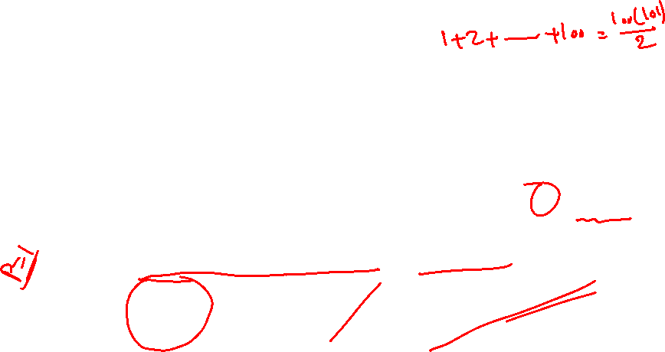
Worst-Case, Best-Case, and Average-Case Efficiencies
The worst-case efficiency C_{Worst} (n) = n.
The best-case efficiency C_{Best} (n) = 1.
The average-case efficiency C_{avg} (n) is calculated as follows:
Notes:
The running time of this algorithm can be quite different for the same list size n. In the worst case, when there are no matching elements or the first matching element happens to be the last one on the list, the algorithm makes the largest number of key comparisons among all possible inputs of size n: C_{worst}(n) = n. This is called the worst-case efficiency of an algorithm.
The way to determine the worst-case efficiency of an algorithm is, in principle, quite straightforward: analyze the algorithm to see what kind of inputs yield the largest value of the basic operation’s count C(n) among all possible inputs of size n and then compute this worst-case value C_{worst}(n).
The best-case efficiency of an algorithm is its efficiency for the best-case input of size n, which is an input (or inputs) of size n for which the algorithm runs the fastest among all possible inputs of that size. To do so, we determine the kind of inputs for which the count C(n) will be the smallest among all possible inputs of size n. (Note that the best case does not mean the smallest input; it means the input of size n for which the algorithm runs the fastest) Then we ascertain the value of C(n) on these most convenient inputs. For example, the best-case inputs for sequential search are lists of size n with their first element equal to a search key; accordingly, C_{best}(n) = 1 for this algorithm.
The analysis of the best-case efficiency is not nearly as important as that of the worst-case efficiency. But it is not completely useless, either. However, it is useful in cases like sorting algorithm (insertion sort) for which the best-case inputs are already sorted or almost-sorted arrays on which the algorithm works very fast.
When we have random input, we need the average-case efficiency to analyze algorithms. In the sequential search, the standard assumptions are that (a) the probability of a successful search is equal to p (0 ≤ p ≤ 1) and (b) the probability of the first match occurring in the ith position of the list is the same for every i. Under these assumptions, we can find the average number of key comparisons C_{avg}(n) as shown above. In the case of a successful search, the probability of the first match occurring in the ith position of the list is p/n for every i, and the number of comparisons made by the algorithm in such a situation is obviously i. In the case of an unsuccessful search, the number of comparisons will be n with the probability of such a search being (1− p).

Slide 8
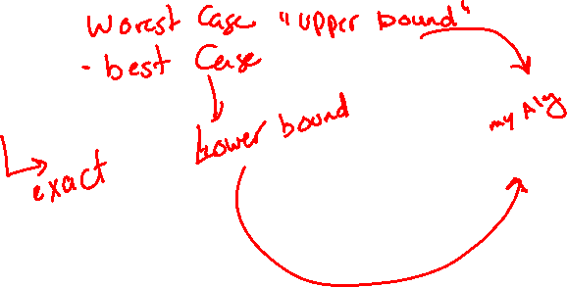
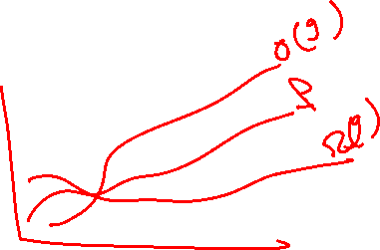
Asymptotic Notations and Basic Efficiency Classes
The efficiency concentrates on the order of growth.
To rank such orders of growth, three notations are used.
O (big oh)
Ω (big omega)
ϴ (big theta).
Notes:
The Algorithm efficiency analysis concentrates on the order of growth of an algorithm’s basic operation count.
To compare and rank such orders of growth, computer scientists use three notations: O (big oh), Ω (big omega), and ϴ (big theta).

Slide 9
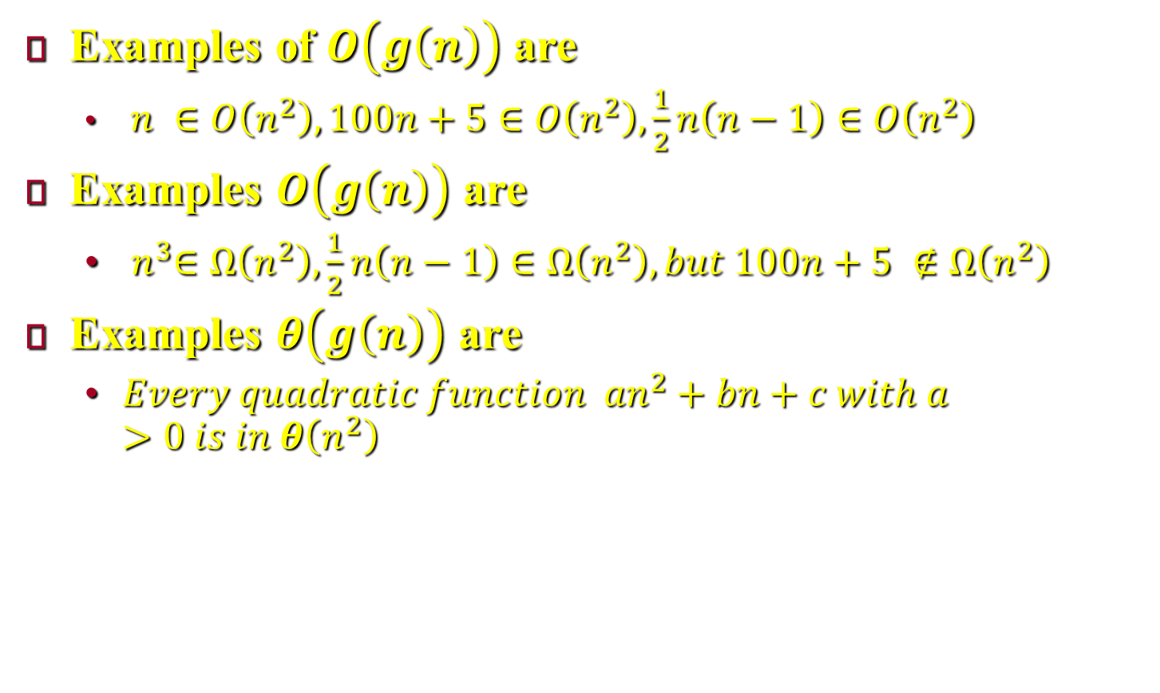

Informal Introduction
Examples of $O\left(g\left(n\right)\right)$ are
$n ∈O\left(n^{2}\right), 100n+5∈O\left(n^{2}\right), \frac{1}{2}n\left(n−1\right)∈O\left(n^{2}\right)$
Examples $O\left(g\left(n\right)\right)$ are
${ n}^{3}∈Ω\left(n^{2}\right), \frac{1}{2}n\left(n−1\right)∈Ω\left(n^{2}\right), but 100n+5 ∉Ω\left(n^{2}\right)$
Examples $θ\left(g\left(n\right)\right)$ are
$Every quadratic function {an}^{2}+bn+c with a>0 is in θ\left(n^{2}\right)$
Notes:
Informally, O(g(n)) is the set of all functions with a lower or same order of growth as g(n). For example, $n ∈O\left(n^{2}\right), 100n+5∈O\left(n^{2}\right), \frac{1}{2}n\left(n−1\right)∈O\left(n^{2}\right)$.
The second notation, $Ω\left(\text{g}\text{(}\text{n}\text{)}\right)$, stands for the set of all functions with a higher or same order of growth as g(n). For example,${ n}^{3}∈Ω\left(n^{2}\right), \frac{1}{2}n\left(n−1\right)∈Ω\left(n^{2}\right), but 100n+5 ∉Ω\left(n^{2}\right)$
Finally, $θ$(g(n)) is the set of all functions that have the same order of growth as g(n). For example,$Every quadratic function {an}^{2}+bn+c with a>0 is in θ\left(n^{2}\right)$

Slide 10
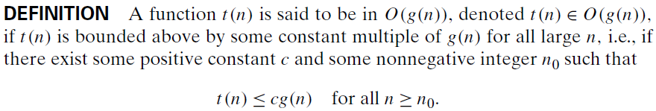
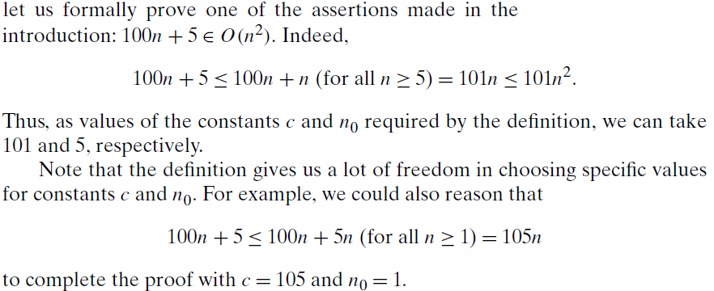

O-notation
Examples

Slide 11
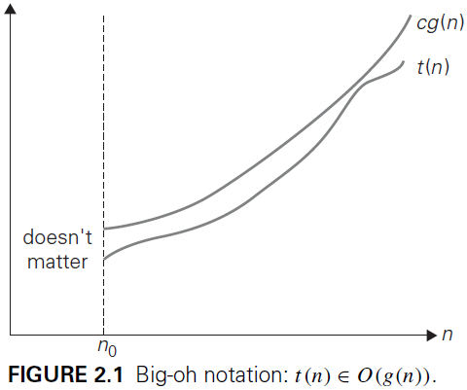

O-notation

Slide 12
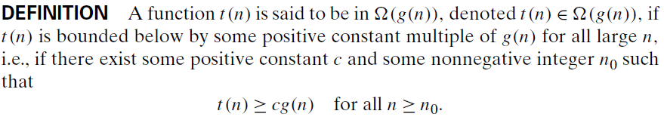
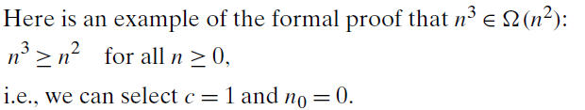
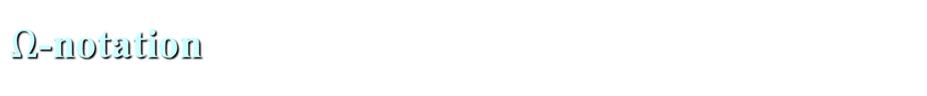

$Ω$-notation
Examples

Slide 13
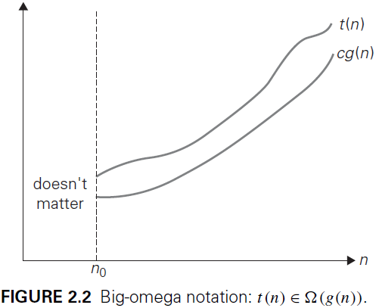
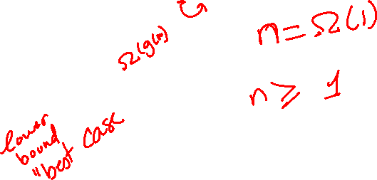
$Ω$-notation

Slide 14
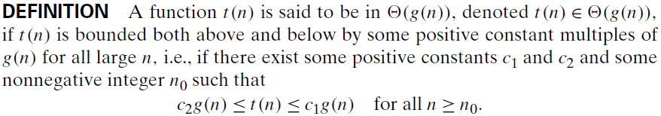
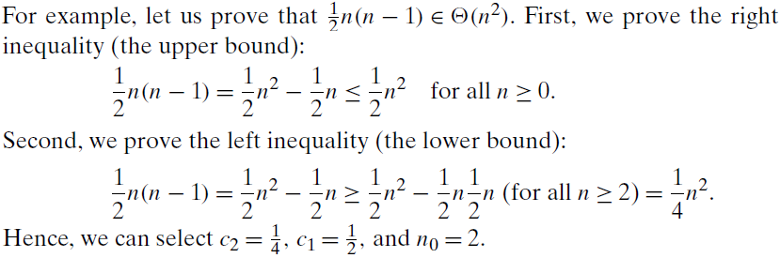

$θ$-notation
Examples

Slide 15
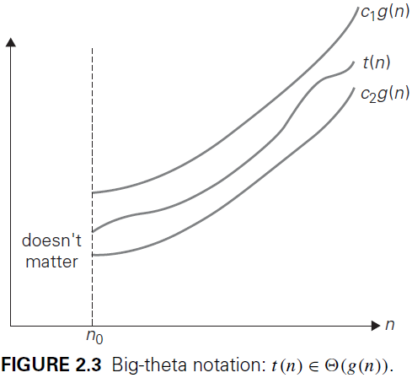
$θ$-notation

Slide 16
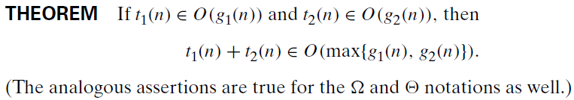
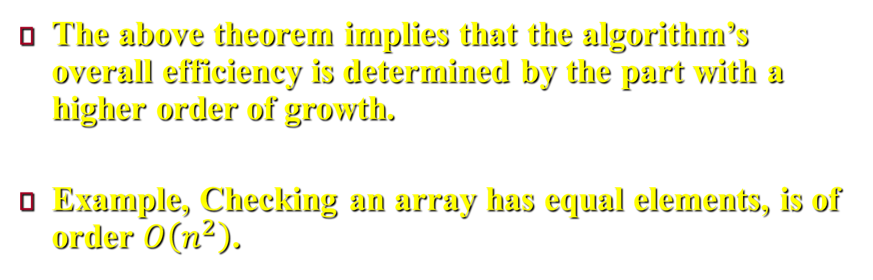
A useful property
The above theorem implies that the algorithm’s overall efficiency is determined by the part with a higher order of growth.
Example, Checking an array has equal elements, is of order $O\left(n^{2}\right)$.
Notes:
The proof of the above theorem is shown in the textbook, page 56.
So what does this property imply for an algorithm that comprises two consecutively executed parts? It implies that the algorithm’s overall efficiency is determined by the part with a higher order of growth, i.e., its least efficient part.
For example, we can check whether an array has equal elements by the following two-part algorithm: first, sort the array by applying some known sorting algorithm; second, scan the sorted array to check its consecutive elements for equality. If, for example, a sorting algorithm used in the first part makes no more than $\frac{1}{2}n\left(n−1\right)$ comparisons (and hence is in $O(n^{2})$) while the second part makes no more than $n − 1$ comparisons (and hence is in $O(n)$), the efficiency of the entire algorithm will be in $O(max⁡\{n^{2}, n\}) = O(n^{2})$.

Slide 17
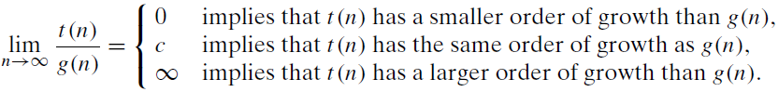
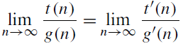
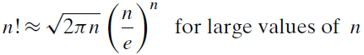
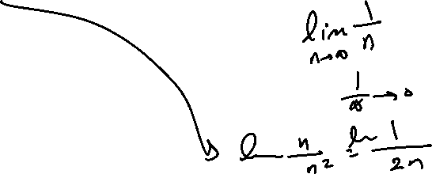



Using Limits for Comparing Orders of Growth
Note that the first two cases mean that $t(n) ∈O(g(n))$, the last two mean that $t(n)∈\text{Ω}(g(n))$, and the second case means that $t(n)∈\text{ϴ}(g(n))$.
L’Hopital’s rule.
Stirling’s formula.
Notes:
The formal definitions of O, $Ω$, and $θ$ are rarely used for comparing the orders of growth of two specific functions. A much more convenient method for doing so is based on computing the limit of the ratio of two functions in question. Three principal cases may arise as shown above. Note that the first two cases mean that $t(n) ∈O(g(n))$, the last two mean that $t(n)∈\text{Ω}(g(n))$, and the second case means that $t(n)∈\text{ϴ}(g(n))$.
The limit-based approach is often more convenient than the one based on the definitions because it can take advantage of the powerful calculus techniques developed for computing limits, such as L’Hopital’s rule and Stirling’s formula.

Slide 18
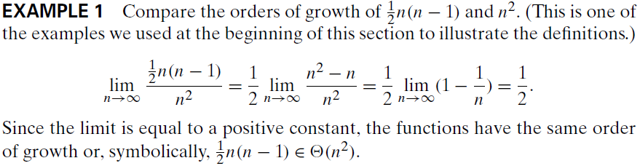
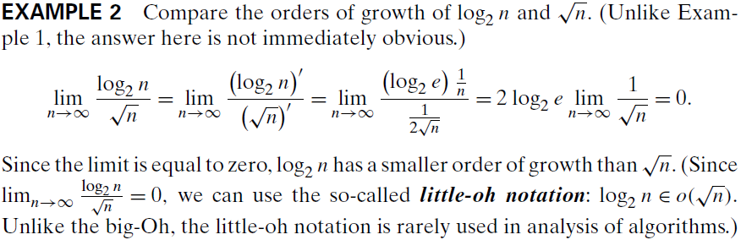
Using Limits for Comparing Orders of Growth

Slide 19
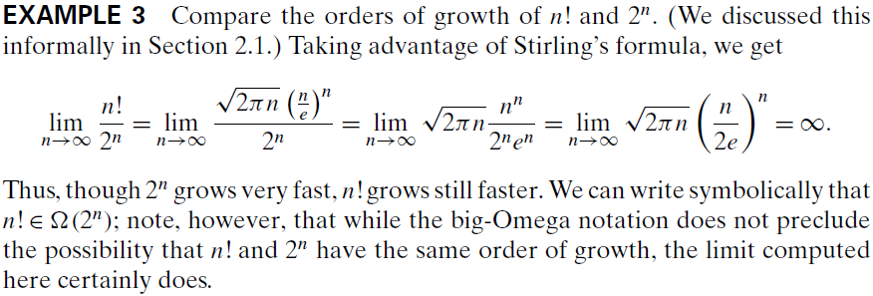
Using Limits for Comparing Orders of Growth

Slide 20
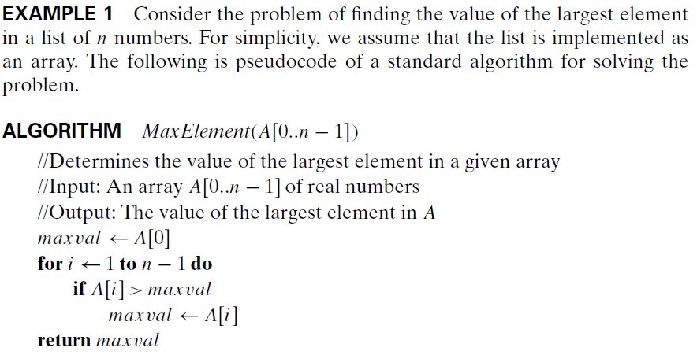
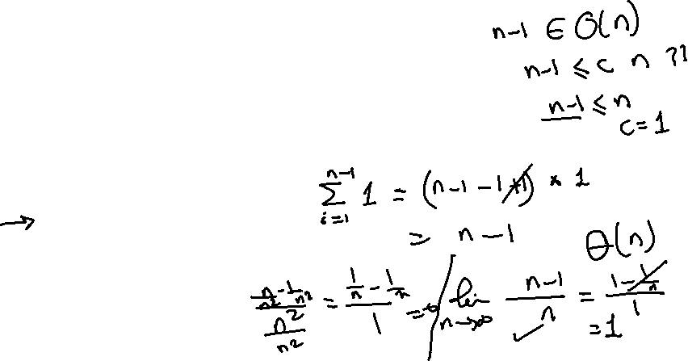
Mathematical Analysis of Nonrecursive Algorithms
Notes:
In this section, we analyze the time efficiency of nonrecursive algorithms mathematically.

Slide 21
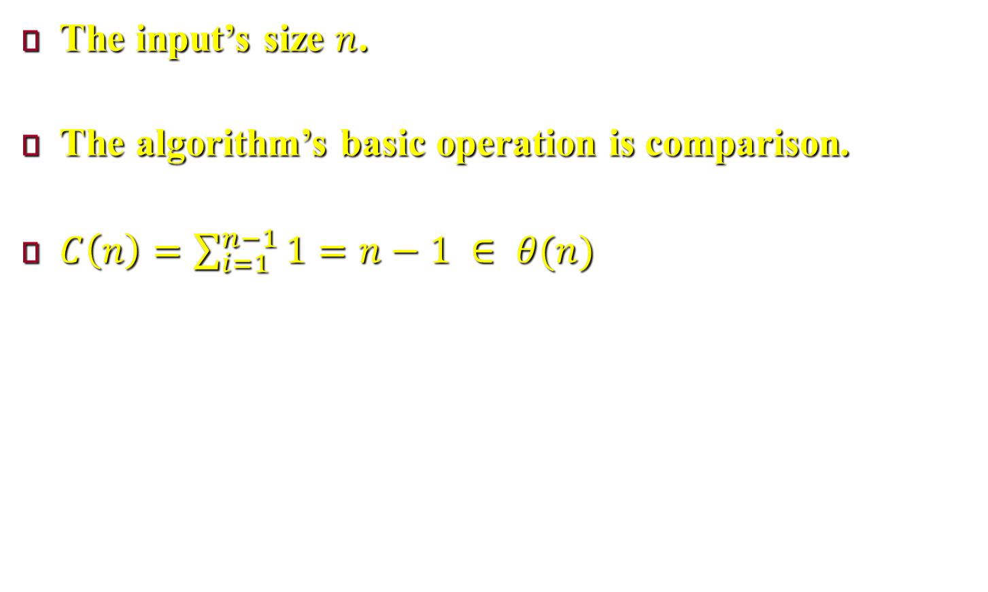
Mathematical Analysis of Nonrecursive Algorithms
The input’s size $n$.
The algorithm’s basic operation is comparison.
$C\left(n\right)=\sum_{i=1}^{n−1}{1}=n−1 ∈ θ(n)$
Notes:
In the previous example, the input’s size is the number of elements in the array, n.
There are two operations in the loop’s body: the comparison A[i]> maxval and the assignment maxval←A[i]. Since the comparison is executed on each repetition of the loop and the assignment is not, we should consider the comparison to be the algorithm’s basic operation. Note that the number of comparisons will be the same for all arrays of size n; therefore, in terms of this metric, there is no need to distinguish among the worst, average, and best cases here.
Let us denote C(n) the number of times this comparison is executed, therefore, $C\left(n\right)=\sum_{i=1}^{n−1}{1}=n−1 ∈ θ(n)$

Slide 22
General Plan for Analyzing the Time Efficiency of Non-recursive Algorithms
Decide which parameter (or parameters) is an input’s size.
Identify the algorithm’s basic operation.
Check the need of ivestigating the worst, average, and best-case efficiencies.
Express the sum of the number of times the algorithm’s basic operation is executed.
Find formula for the count or, establish its order of growth
Notes:
Decide on a parameter (or parameters) indicating an input’s size.
Identify the algorithm’s basic operation. (As a rule, it is located in the innermost loop).
Check whether the number of times the basic operation is executed depends only on the size of an input. If it also depends on some additional property, the worst-case, average-case, and, if necessary, best-case efficiencies have to be investigated separately.
Set up a sum expressing the number of times the algorithm’s basic operation is executed.
Using standard formulas and rules of sum manipulation, either find a closed form formula for the count or, at the very least, establish its order of growth.

Slide 23
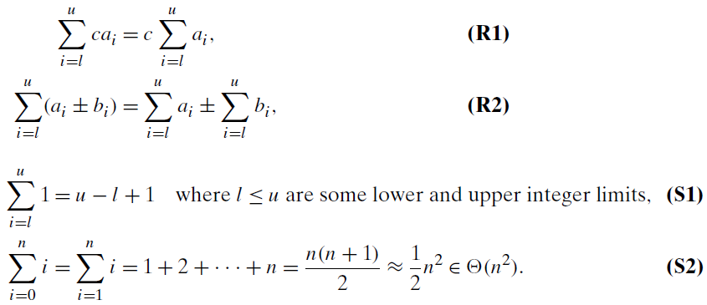
Useful rules for summation formulas

Slide 24
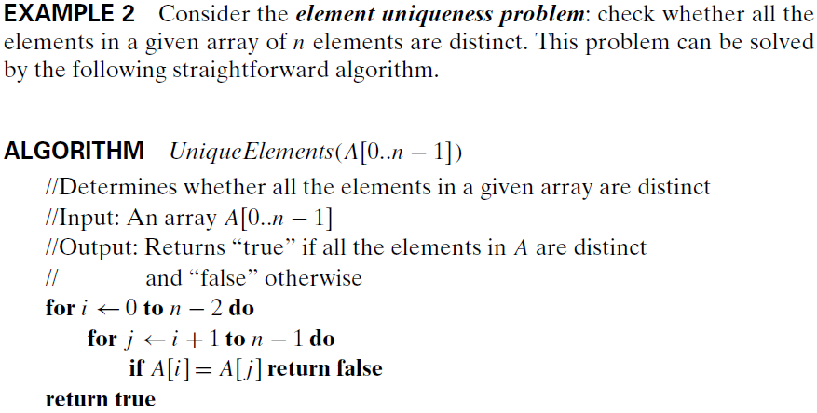
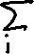
Mathematical Analysis of Nonrecursive Algorithms

Slide 25
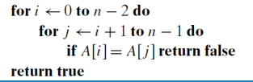



Slide 26
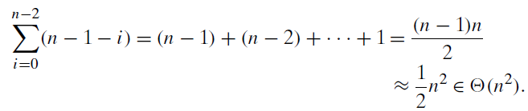
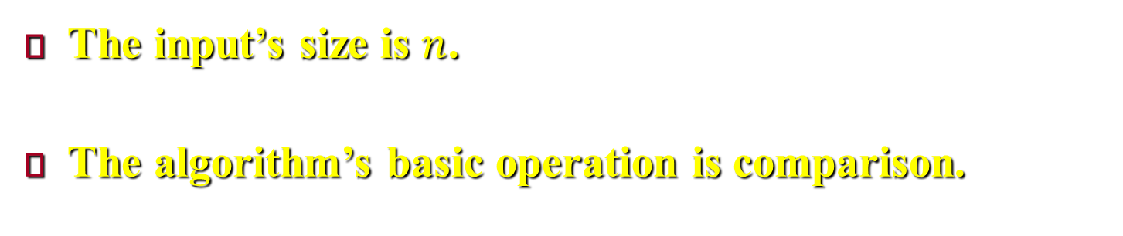
Mathematical Analysis of Nonrecursive Algorithms
The input’s size is $n$.
The algorithm’s basic operation is comparison.
Notes:
In the previous example, the input’s size is the number of elements in the array, n.
Since the innermost loop contains a single operation (the comparison of two elements), we should consider it as the algorithm’s basic operation. Note, however, that the number of element comparisons depends not only on n but also on whether there are equal elements in the array (because return false will terminate the function) and, if there are, which array positions they occupy. We will limit our investigation to the worst case only.
Here, the worst case happens when the array has no equal elements or when it has the last two elements are the only pair of equal elements.
Accordingly, $C_{Worst}\left(n\right)$ is calculated as shown above. Note that, $S_{n}=\frac{n}{2}\left[2a+\left(n−1\right)d\right]$, where $n$ is the number of terms, $a$ is the first term, $d$ is the basis

Slide 27
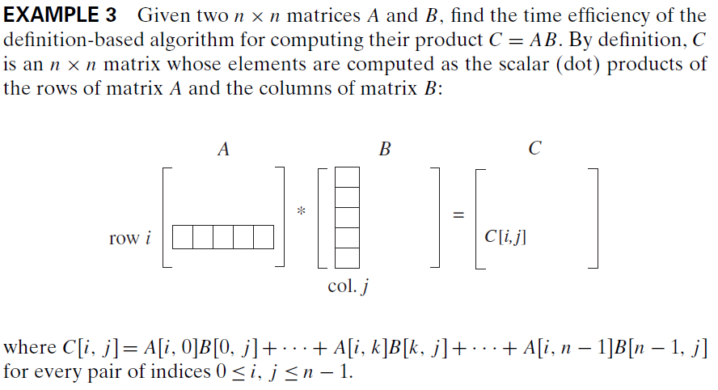
Mathematical Analysis of Nonrecursive Algorithms

Slide 28
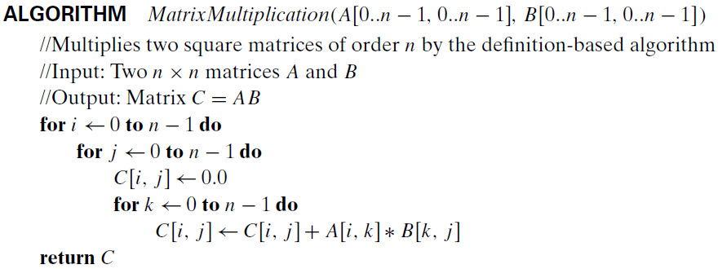
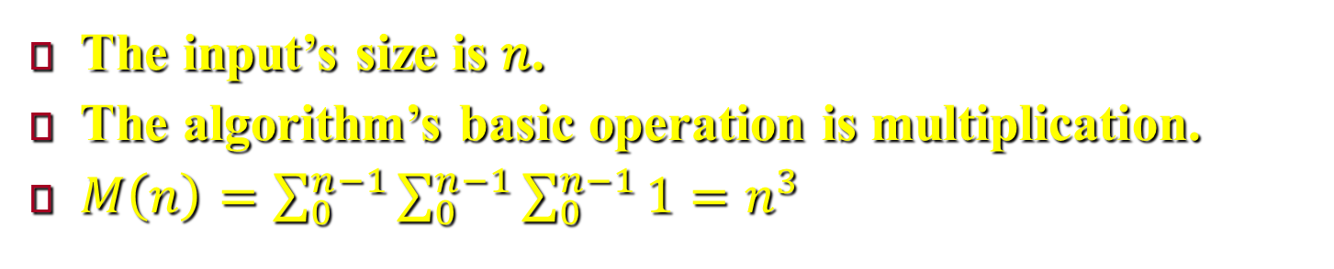
Mathematical Analysis of Nonrecursive Algorithms
The input’s size is 𝑛.
The algorithm’s basic operation is multiplication.
$M\left(n\right)=\sum_{0}^{n−1}{\sum_{0}^{n−1}{\sum_{0}^{n−1}{1}}}=n^{3}$
Notes:
We measure an input’s size by matrix order n.
There are two arithmetical operations in the innermost loop here — multiplication and addition — we do not have to choose between them, because on each repetition of the innermost loop each of the two is executed exactly once. So by counting one we automatically count the other. But to follow a well-established tradition, we consider multiplication as the basic operation (as it consumes more time).
The number of multiplications, M(n) (Since this count depends only on the size of the input matrices, we do not have to investigate other efficiencies).
$M\left(n\right)=\sum_{0}^{n−1}{\sum_{0}^{n−1}{\sum_{0}^{n−1}{1}}}=n^{3}$

Slide 29
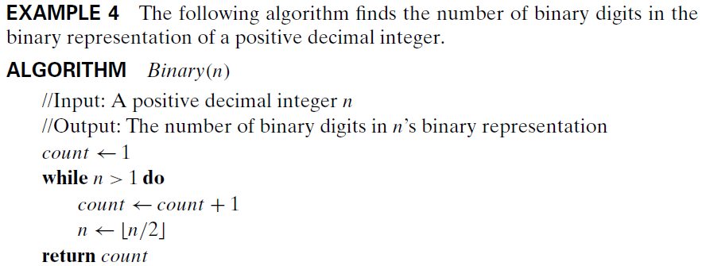
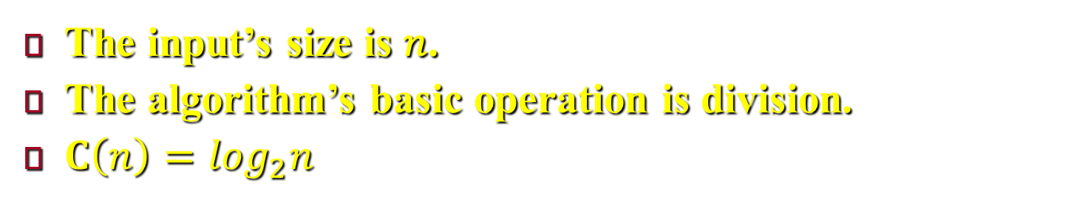
Mathematical Analysis of Nonrecursive Algorithms
The input’s size is 𝑛.
The algorithm’s basic operation is division.
$C\left(n\right)=\log_{2}n$
Notes:
First, notice that the most frequently executed operation here is not inside the while loop but rather the comparison n > 1 that determines whether the loop’s body will be executed. Since the number of times the comparison will be executed is larger than the number of repetitions of the loop’s body by exactly 1, the choice is not that important. We choose division as basic operation.
A more significant feature of this example is the fact that the loop variable takes on only a few values between its lower and upper limits; therefore, we have to use an alternative way of computing the number of times the loop is executed. Since the value of n is about halved on each repetition of the loop, the answer should be about $\log_{2}n$.

Slide 30
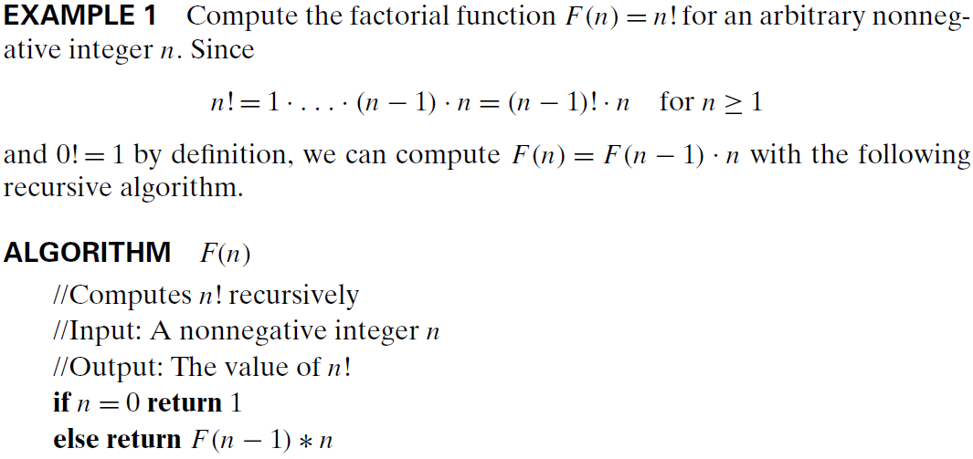

Mathematical Analysis of Recursive Algorithms
Notes:
Here, we discuss how to apply the general framework for analysis of algorithms to recursive algorithms. We start with the above example.

Slide 31
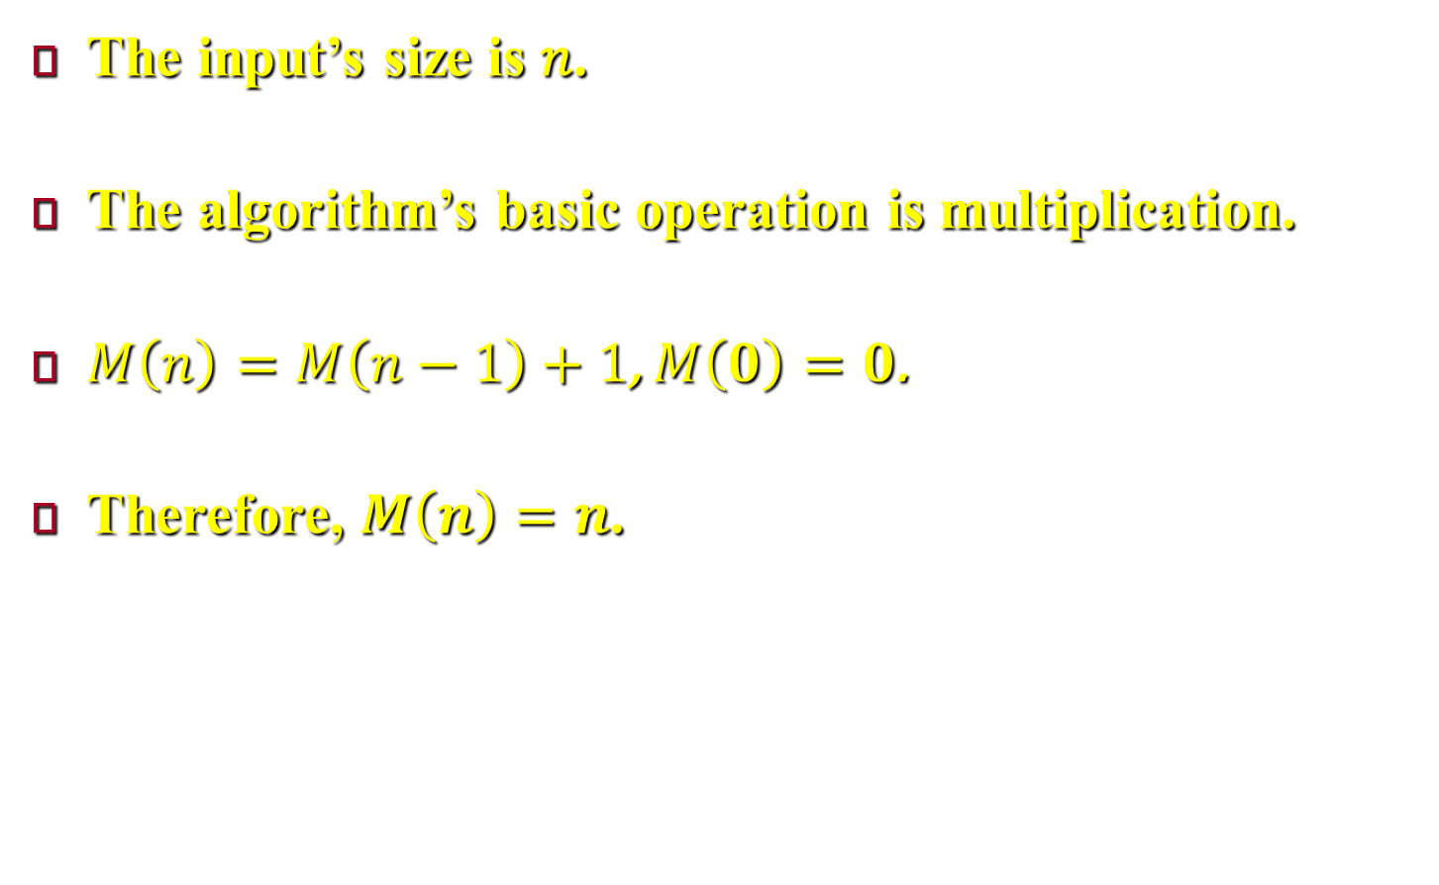
Mathematical Analysis of Recursive Algorithms
The input’s size is 𝑛.
The algorithm’s basic operation is multiplication.
$M\left(n\right)=M\left(n−1\right)+1$, $M\left(0\right)=0$.
Therefore, $M\left(n\right)=n$.
Notes:
For simplicity, we consider n itself as an indicator of this algorithm’s input size (rather than the number of bits in its binary expansion).
We denote $M\left(n\right)$ the number of multiplications.
$M\left(n\right)=M\left(n−1\right)+1$, where $M\left(n−1\right)$ is the number of multiplications spent to compute $F(n−1)$. Any function like $M\left(n\right)$ which is a function of its value at another point ($n−1$) recurrence relation (or recurrence).
To determine a solution uniquely, we need an initial condition that tells us the value with which the sequence starts. In this problem the initial condition is $n=0$ because the algorithm stops when $n=0$ (if n = 0 return 1), and in this case the algorithm performs no multiplications, i.e. $M\left(0\right)=0$.
Since $M\left(n\right)=M\left(n−1\right)+1$, substituting $M\left(n−1\right)$, $M\left(n\right)=\left[M\left(n−2\right)+1\right]+1=M\left(n−2\right)+2$, substituting $M\left(n−2\right)$, $M\left(n\right)=\left[M\left(n−3\right)+1\right]+2=M\left(n−3\right)+3$
i.e. $M\left(n\right)=M\left(n−i\right)+i$, when $i=n$, $M\left(n\right)=M\left(n−n\right)+n=M\left(0\right)+n=0+n=n$.

Slide 32
General Plan for Analyzing the Time Efficiency of Recursive Algorithms
Decide which parameter (or parameters) is an input’s size.
Identify the algorithm’s basic operation.
Check the need of ivestigating the worst, average, and best-case efficiencies.
Derive a recurrence relation, with an appropriate initial condition, for the number of times the basic operation is executed.
Find formula for the count or, establish its order of growth
Notes:
Decide on a parameter (or parameters) indicating an input’s size.
Identify the algorithm’s basic operation. (As a rule, it is located in the innermost loop).
Check whether the number of times the basic operation is executed depends only on the size of an input. If it also depends on some additional property, the worst-case, average-case, and, if necessary, best-case efficiencies have to be investigated separately.
Set up a recurrence relation, with an appropriate initial condition, for the number of times the basic operation is executed.
Solve the recurrence or, at least, ascertain the order of growth of its solution.

Slide 33
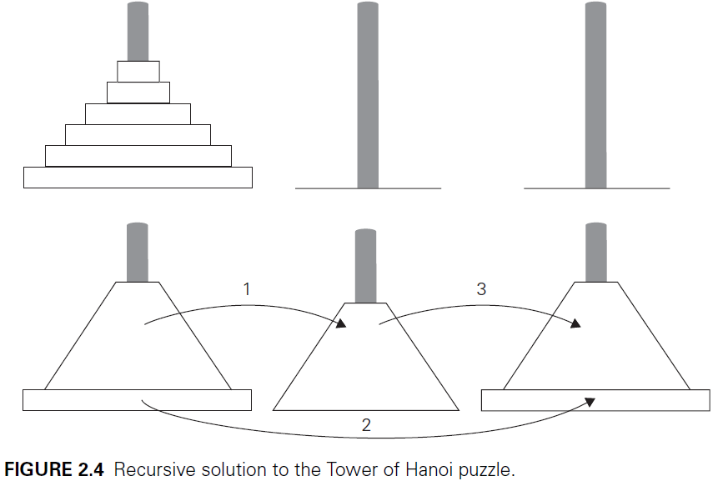
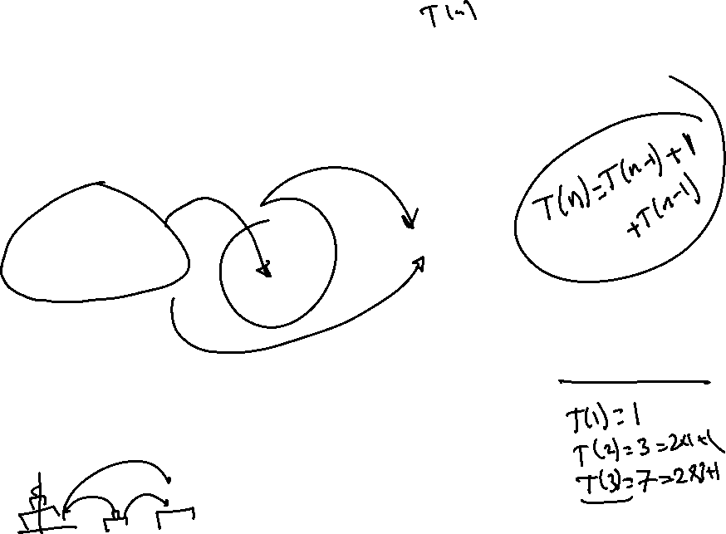
Mathematical Analysis of Recursive Algorithms
Notes:
In the Tower of Hanoi puzzle puzzle, we have n disks of different sizes that can slide onto any of three pegs. Initially, all the disks are on the first peg in order of size. The goal is to move all the disks to the third peg, using the second one as an auxiliary, if necessary. We can move only one disk at a time, and it is forbidden to place a larger disk on top of a smaller one. For more details.
The problem has an elegant recursive solution, which is illustrated in Figure 2.4. To move $n>1$ disks from peg 1 to peg 3 (with peg 2 as auxiliary), we first move recursively $n − 1$ disks from peg 1 to peg 2 (with peg 3 as auxiliary), then move the largest disk directly from peg 1 to peg 3, and, finally, move recursively $n − 1$ disks from peg 2 to peg 3 (using peg 1 as auxiliary). Of course, if n = 1, we simply move the single disk directly from the source peg to the destination peg. (see the associated video).

Slide 34


Slide 35
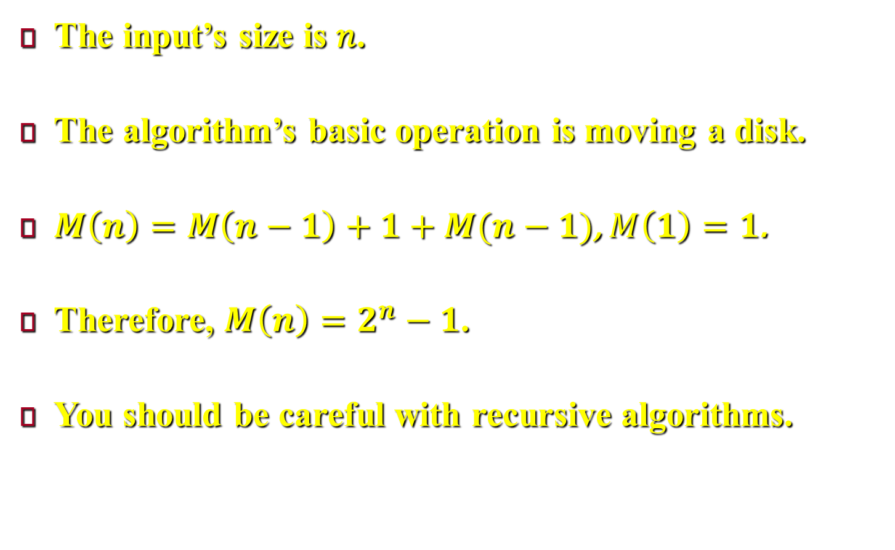
Mathematical Analysis of Recursive Algorithms
The input’s size is 𝑛.
The algorithm’s basic operation is moving a disk.
$M\left(n\right)=M\left(n−1\right)+1+M(n−1)$, $M\left(1\right)=1$.
Therefore, $M\left(n\right)=2^{n}−1$.
You should be careful with recursive algorithms.
Notes:
Here, the input’s size is the number of disks, n.
The algorithm’s basic operation is moving one disk.
Clearly, the number of moves $M(n)$ depends on n only, and we get the following recurrence equation for it: $M\left(n\right)=M\left(n−1\right)+1+M\left(n−1\right) for n>1, M\left(1\right)=1$.
The initial condition is $M(1)=1$.
$M\left(n\right)=2M\left(n−1\right)+1=2\left[2M\left(n−2\right)+1\right]+1=4M\left(n−2\right)+3=4\left[2M\left(n−3\right)+1\right]+3=8M\left(n−3\right)+7=2^{i}M\left(n−i\right)+2^{i}−1$.
Put $i=n−1$, then $M\left(n\right)=2^{n−1}M\left(1\right)+2^{n−1}−1=2^{n−1}×1+2^{n−1}−1=2^{n}−1$.
Thus the above algorithm is exponential. This example shows that one should be careful with recursive algorithms.

Slide 36
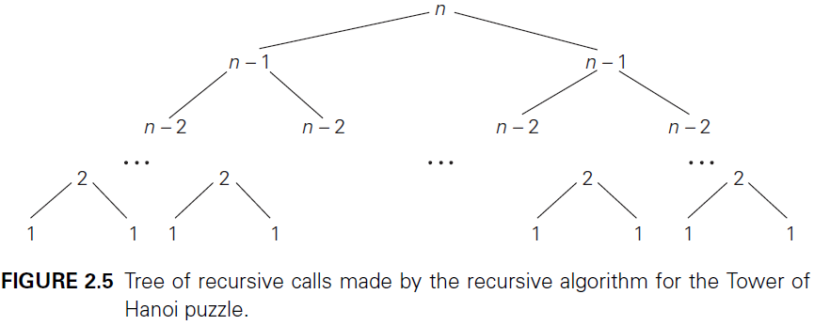
Mathematical Analysis of Recursive Algorithms
Notes:
When a recursive algorithm makes more than a single call to itself, it can be useful for analysis purposes to construct a tree of its recursive calls. In this tree, nodes correspond to recursive calls, and we can label them with the value of the parameter (or, more generally, parameters) of the calls.

Slide 37


Mathematical Analysis of Recursive Algorithms

Slide 38

Mathematical Analysis of Recursive Algorithms
The input’s size is 𝑛.
The algorithm’s basic operation is addition.
$A\left(n\right)=A(\left\lfloor \frac{n}{2}\right\rfloor )+1$, $A\left(1\right)=0$.
Therefore, $A\left(n\right)=\log_{2}n ∈θ(log n)$.
Notes:
Here, the input’s size is n.
The algorithm’s basic operation is addition.
$A\left(n\right)=A\left(⌊n/2⌋\right)+1 for n>1, A\left(1\right)=0$.
The initial condition is $A(1)=0$.
We put $n=2^{k}$ then $A\left(2^{k}\right)={A(2}^{k−1})+1=\left[{A(2}^{k−2})+1\right]+1={A(2}^{k−2})+2=\left[{A(2}^{k−3})+1\right]+2={A(2}^{k−3})+3={A(2}^{k−i})+i$.
Put $i=k$, then $A\left(2^{k}\right)={A(2}^{k−k})+k={A(2}^{0})+k=A\left(1\right)+k=0+k=k$.
Since $n=2^{k}$ Then $A\left(n\right)=\log_{2}n ∈ θ(\log{n})$

